Slide 1



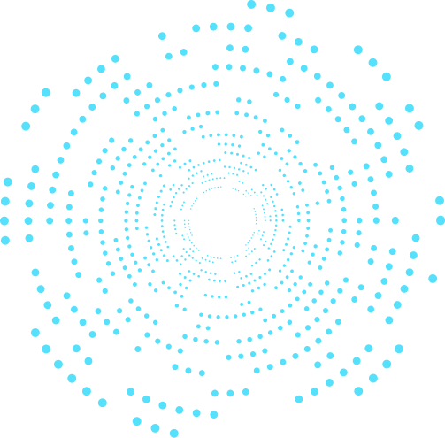


AI PLATFORM PROJECT
3D Mesh Deformation and Optimization

Slide 2
TABLE OF CONTENT
01
Introduction
02
Background
03
04
Results
Implementation

Slide 3
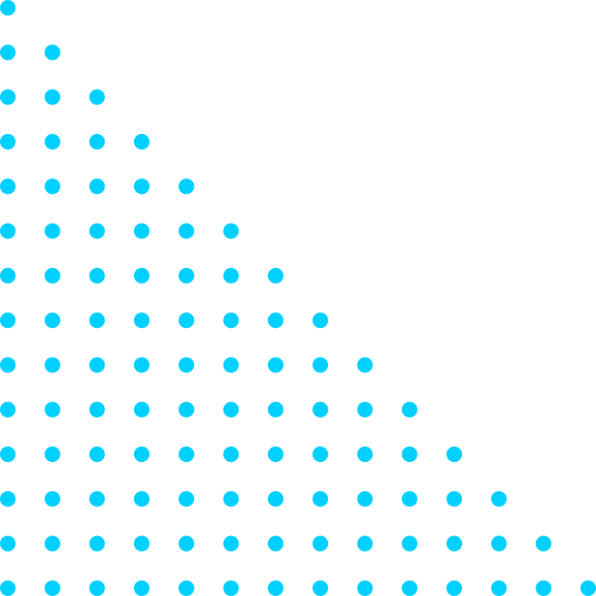

INTRODUCTION
The main objective of this project is to deform a 3D mesh to match a target shape through an optimization process.
This involves adjusting the vertices of the mesh to minimize the difference between the predicted mesh and the target mesh.

Slide 4
3D mesh deformation and optimization play a crucial role in various applications such as:
Computer Graphics: Deforming meshes is essential for character animation, shape modeling, and virtual reality applications.
Computer Vision: It is used in object recognition, shape analysis, and 3D reconstruction from images or videos.
Medical Imaging: Deforming meshes can help in modeling and analyzing anatomical structures.
Engineering: Mesh deformation is important in finite element analysis and simulations.

Slide 5


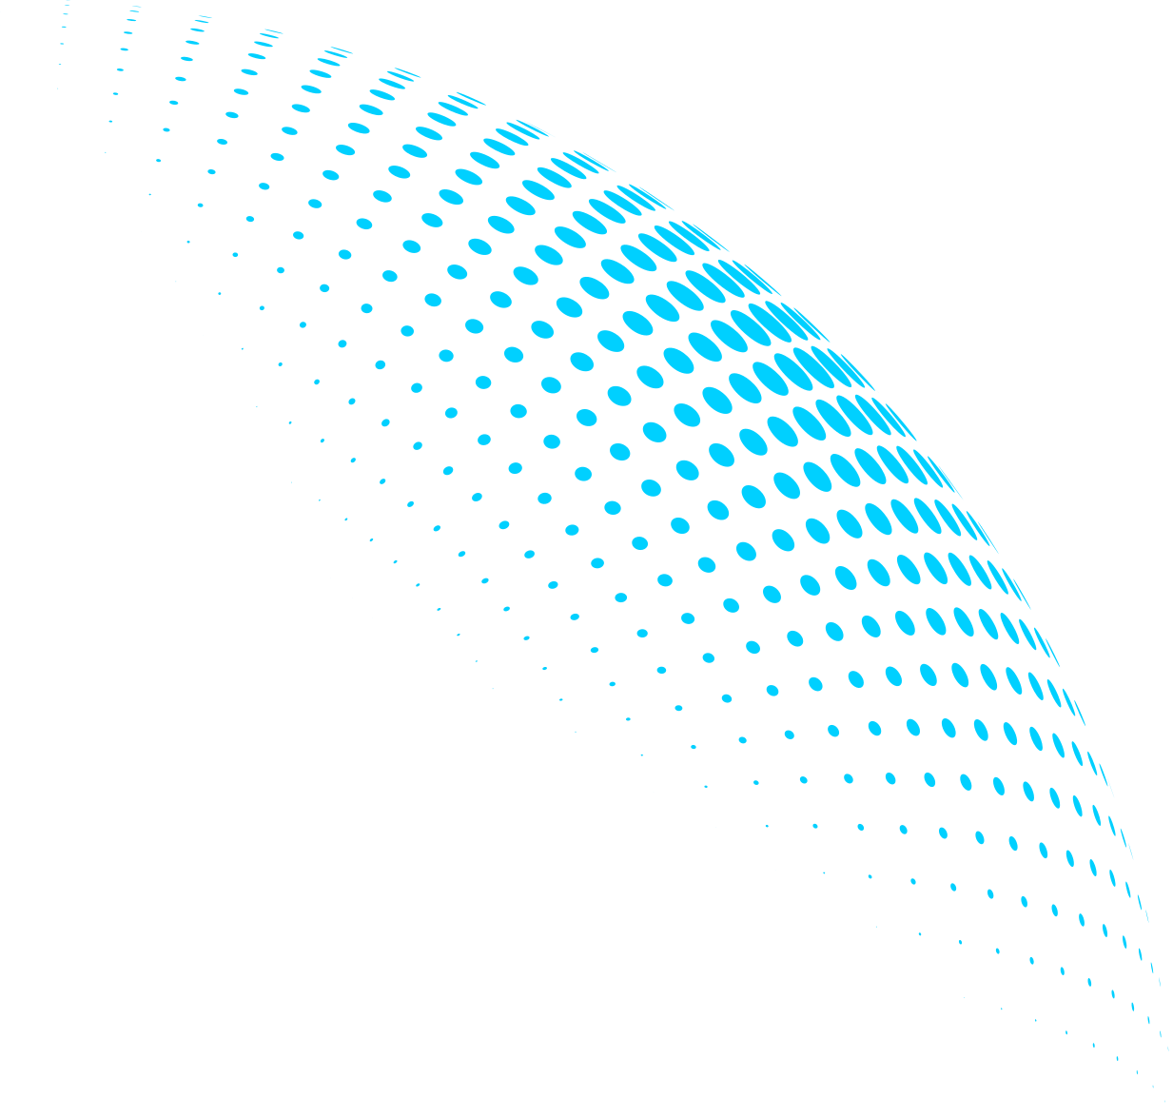
02
BACKGROUND
3D Meshes and Their Representation:
In computer graphics, a 3D mesh is a collection of vertices, edges, and faces that define the shape of a 3D object. Each vertex is a point in 3D space, and edges connect vertices to form faces, which are polygons that make up the surface of the object.
Meshes are commonly represented using two main data structures:
Vertex List: A list of vertices, where each vertex is represented by its coordinates (x, y, z).
Face List: A list of faces, where each face is represented by a list of indices pointing to the vertices that make up the face.

Slide 6
02
BACKGROUND
Source and Target Meshes:
Source Mesh: The source mesh is the initial mesh that we start with. In this project, we initialize the source mesh as a sphere of radius 1.
Target Mesh: The target mesh is the desired shape that we want the source mesh to deform into. It is provided as input to the optimization process.

Slide 7
02
BACKGROUND
Rendering and Visualization Techniques
Rendering: Rendering is the process of generating a 2D image from a 3D scene. In this project, we use a renderer to render the meshes from different viewpoints.
Visualization: Visualization techniques are used to display the 3D meshes and their properties in a meaningful way. We use visualization to compare the predicted mesh with the target mesh and to visualize the optimization progress.

Slide 8
02
BACKGROUND
Optimization Approach:
Stochastic Gradient Descent (SGD)
Stochastic Gradient Descent (SGD) is a popular optimization algorithm used to minimize a loss function. In this project, we use SGD to optimize the deformation parameters of a 3D mesh. SGD iteratively updates the parameters in the direction that reduces the loss, eventually converging to a solution.

Slide 9
02
BACKGROUND
Loss Functions
Silhouette Loss: The silhouette loss measures the difference between the predicted silhouette of the deformed mesh and the target silhouette. It is calculated as the squared L2 distance between the two silhouettes.
Mesh Edge Loss: The mesh edge loss penalizes deviations from the original edge lengths of the mesh. It helps maintain the shape and structure of the mesh during deformation.
Mesh Laplacian Smoothing: Laplacian smoothing is used to regularize the mesh shape. It encourages smoothness in the mesh by penalizing abrupt changes in vertex positions.

Slide 10
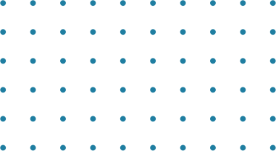
IMPLEMENTATION
1
2
3
Mesh initialization
Rendering setup
Optimization loop
4
5
Visualization and rendering
Final mesh export

Slide 11


OUR PRODUCT
THE FUTURE
FUTURE
Computer Graphics and Animation
Computer Vision
Medical Imaging
Engineering and Simulation
Art and Design

Slide 12
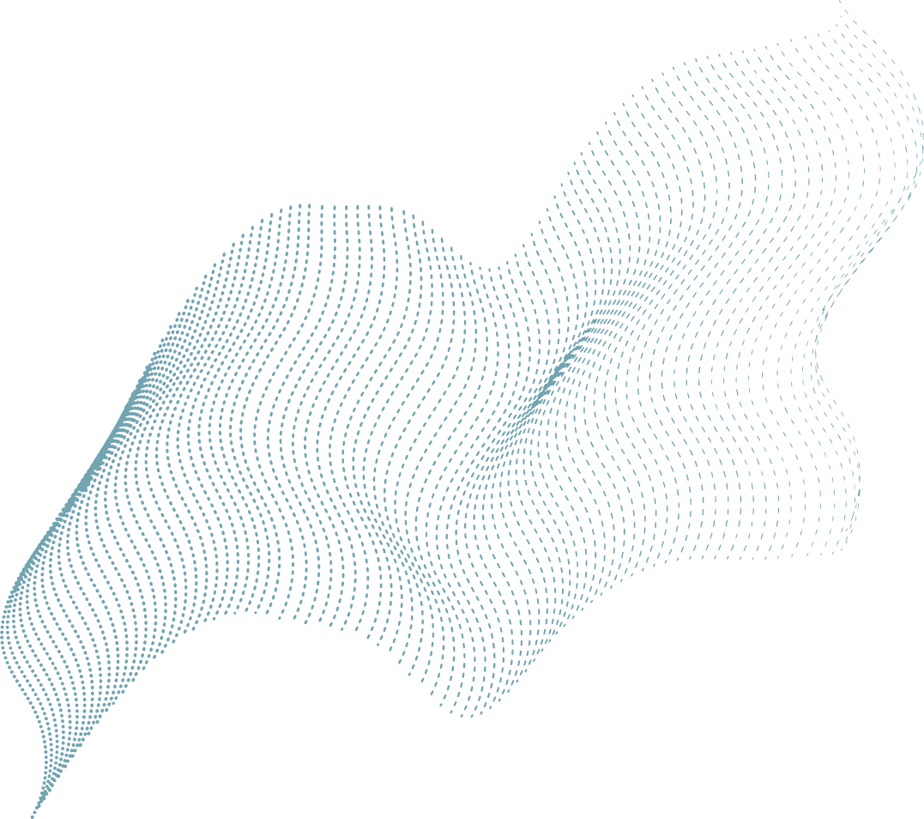

OUR TEAM
MARINA GEORGE
PETER HANY
CARINE EMAD
SEVEEN SAMIR
SANDRA WASSIM

Slide 13
Thanks!
Do you have questions?

